Slide 1



SANJAY K 20BCE0020
SANJIT NARAYANAN G 20BCE0052
WIN REVANS B 20BCE0971
DATA ENGINEERING TRAINING
AZURE DATA MONITORING FOR TOKYO OLYMPICS DATA
Aathirainathan P
Ambati Sesha Sai Sahithya
Eswara Venkata Sai Raja

Slide 2

PROJECT OVERVIEW
Leveraged Azure tools to ensure data quality and trustworthiness for Tokyo Olympics datasets.
Key Tools: Azure Data Factory, Databricks, Data Lake Storage.
Key Features:
Monitoring and validating 10 data quality metrics.
Automating workflows for analytics and decision-making.
Tools: Azure Data Factory, Azure Databricks, Power BI.

Slide 3
PROJECT REQUIREMENTS
Automate and scale data pipelines for ingesting data from GitHub to Azure Data Lake.
Perform data quality checks for inconsistencies
Store metrics for reporting and decision-making.
Store metrics for reporting and decision-making.

Slide 4
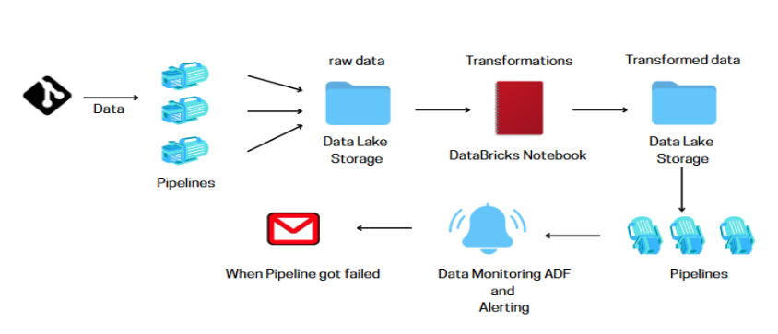
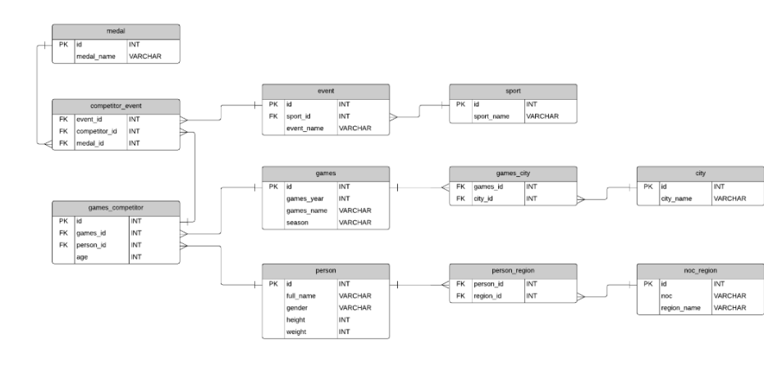
Architectural & ER Diagram

Slide 5
Workflow:
Step 1: Ingestion (Bronze Zone):
Raw data ingested into Azure Data Lake (Bronze Zone).
Step 2: Transformation (Silver Zone):
Cleaned data prepared for analysis (Silver Zone).
Step 3: Analytical Zone (Gold Zone):
Aggregated data optimized for visualization (Gold Zone).

Slide 6
Workflow:
Step 4: Data Quality Monitoring :
Monitoring the data through Azure Monitor For every Trigger
Step 5: Set New Alerts :
Setting up Alerts when pipeline got failed and send mail to the given Email ID.

Slide 7
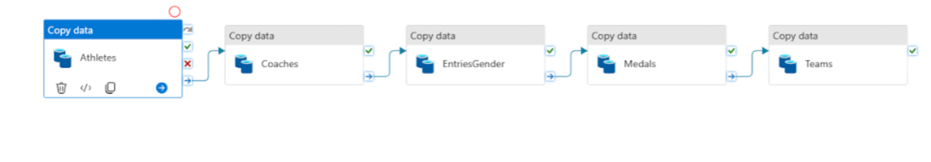
DESIGN

Slide 8
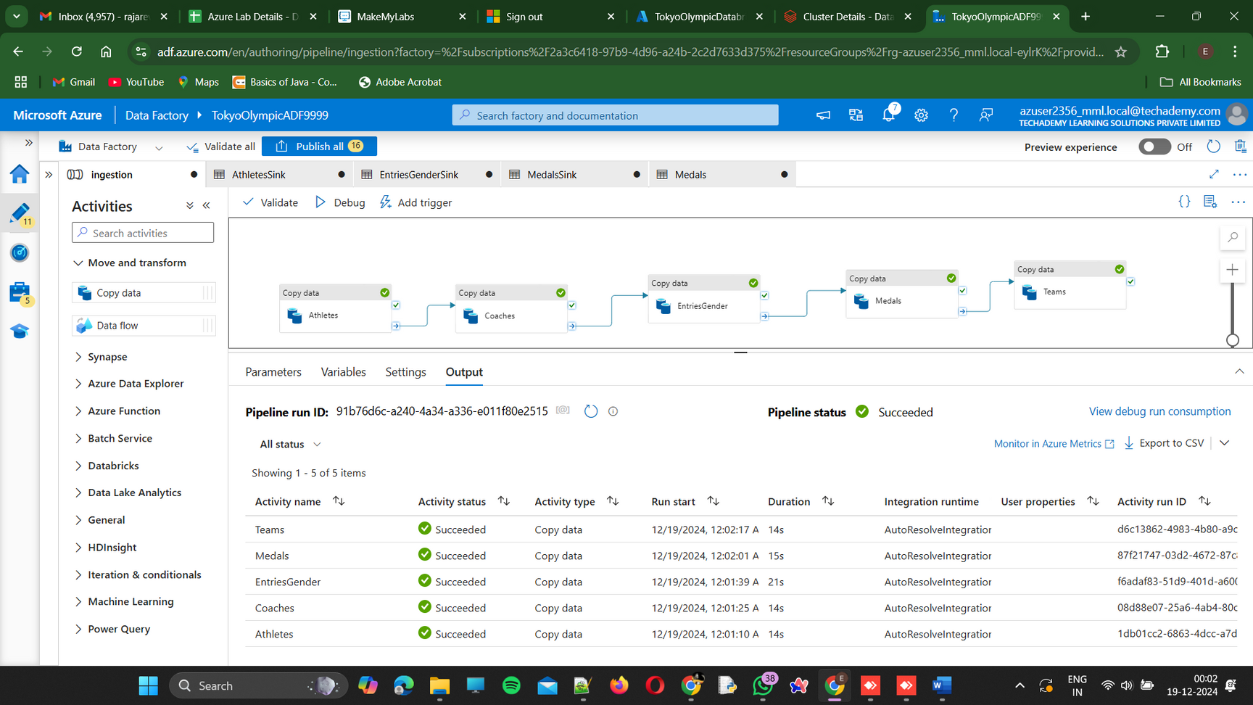
TASKS DONE

Slide 9
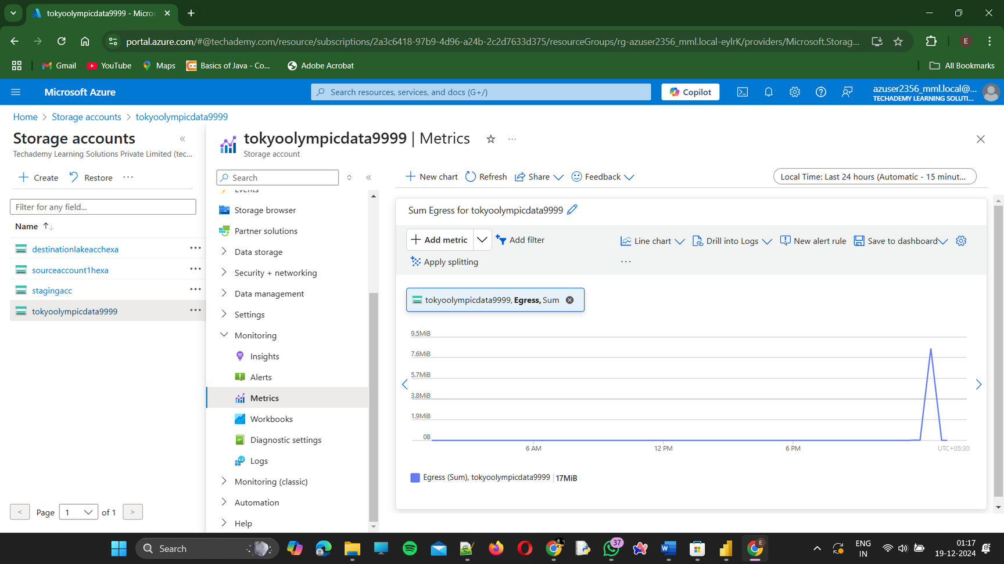
TASKS DONE

Slide 10
CONCLUSION
Successfully implemented a scalable pipeline for Tokyo Olympics data:
Ensured high data quality.
Enabled proactive monitoring and reporting.
Delivered insights for decision-making.

Slide 11

SANJAY K 20BCE0020
SANJIT NARAYANAN G 20BCE0052
WIN REVANS B 20BCE0971
THANK YOU
Submitted by:
Aathirainathan P

